Slide 1
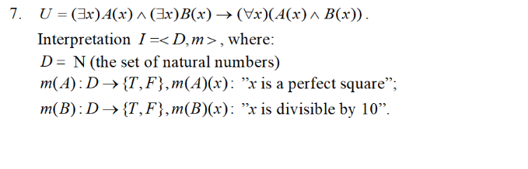
Problem Statement

Slide 2
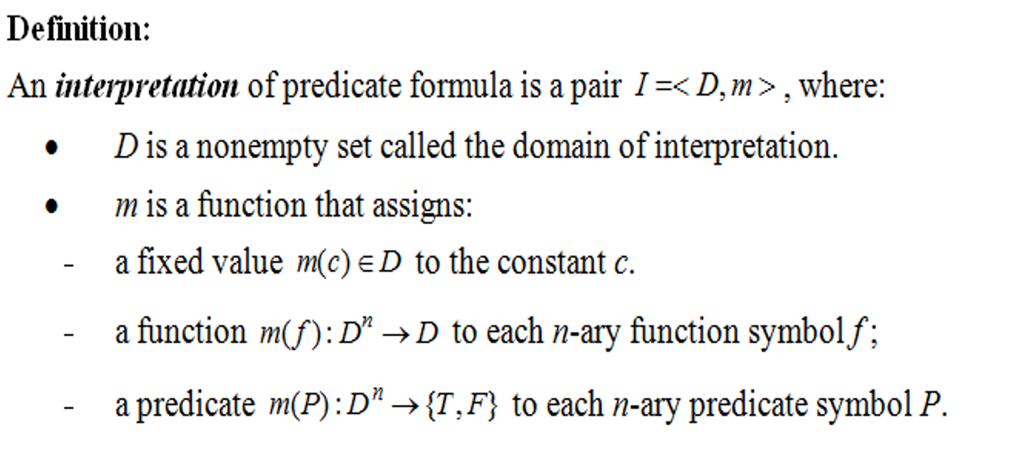
Theoretical result

Slide 3
v^{I1}(U) = v^{I1}( (∃x)A(x) ^ (∃x)B(x) )→ v^{I1}(∀(x)(A(x)^B(x)) )
= v^{I1}(∃x)A(x)) ^ v^{I1}((∃x)B(x)) → v^{I1}(∀(∃x) (A(x)^B(x)) )
= (∃x)_{xϵN}(x is a perfect square) ^ (∃x)_{xϵN}(x is divisible by 10) → (∀x)_{xϵN}(x is a perfect square ^ x is divisible by 10 )
= T ^ T → F = T → F = F
v^{I1}(U) = F , U is evaluated as false under the interpretation I1 which is a anti-model of U.

